Slide 1

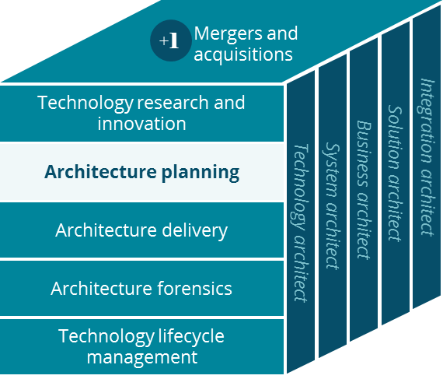
HealthHUB
Business Canvas
Architecture Planning
Kathy Filkins
8/1/2019

Slide 2
HealthHUB Business Canvas
Holistic view of the current CVS HealthHUB business model
Key Partnerships
Key Activities
Value Proposition
Customer Relationships
Customer Segment
Clinical affiliations
Personalized Pharmacy Support
Managing Chronic Conditions
Transforming the consumer health experience, connecting with people in their communities
Retail Customer
Patients
Health Care Services & Encounters
Wellness & Education Programs
Affiliations
Community Service Providers
US domestic population
Primary care doctors
Convenient, personalized and integrated access to health care support and services
Nutritional health
DME and services
Health plans
Improving care for patients managing chronic conditions, with a focus on next best clinical actions and driving medical costs savings
Channels
Customer Engagement & Care Coordination
Inventory Management
In person
Email
Providers & Provider Networks
Key Resources
Phone, text
Web/ Mobile app
Social service providers
Care Concierge
Local real-estate
Innovative health care model that will create an entirely new consumer experience and help people on their path to better health
Community Partners
Skilled RPhs, NPs, and Care Managers
Tele-medicine
Video Visit
Supply-chain & Logistics
One stop medical center- for fast, cost-effective, convenient, reliable diagnosis and treatment services
Suppliers & Logistics
Digital and on-demand health tools (e.g. Learning Tables)
MinuteClinic &
Pharmacy
Cost Structure
Revenue Streams
Wages for pharmacists, nurse practitioners, care managers and support staff
Customer out of pocket payment for products and services
Store real-estate is very expensive especially in urban areas.
Health insurance payments for qualified prescriptions, products and clinical services
Infrastructure costs for build out of 1,500 HealthHUB locations
Health plan, Employer and Provider Network payments for enrolled programs delivered in the HealthHub

